Slide 1
SPROCKET CENTRAL PTY Ltd. PROJECT DESCRIPTION
By Oyelade David

Slide 2
Project Objectives
01
02
Introduction
Data Exploration
Model Development
03
04
Interpretation

Slide 3
About the Project
Performing Data Insights.
Targeting high value customers based on customer demographics and attributes.

Slide 4
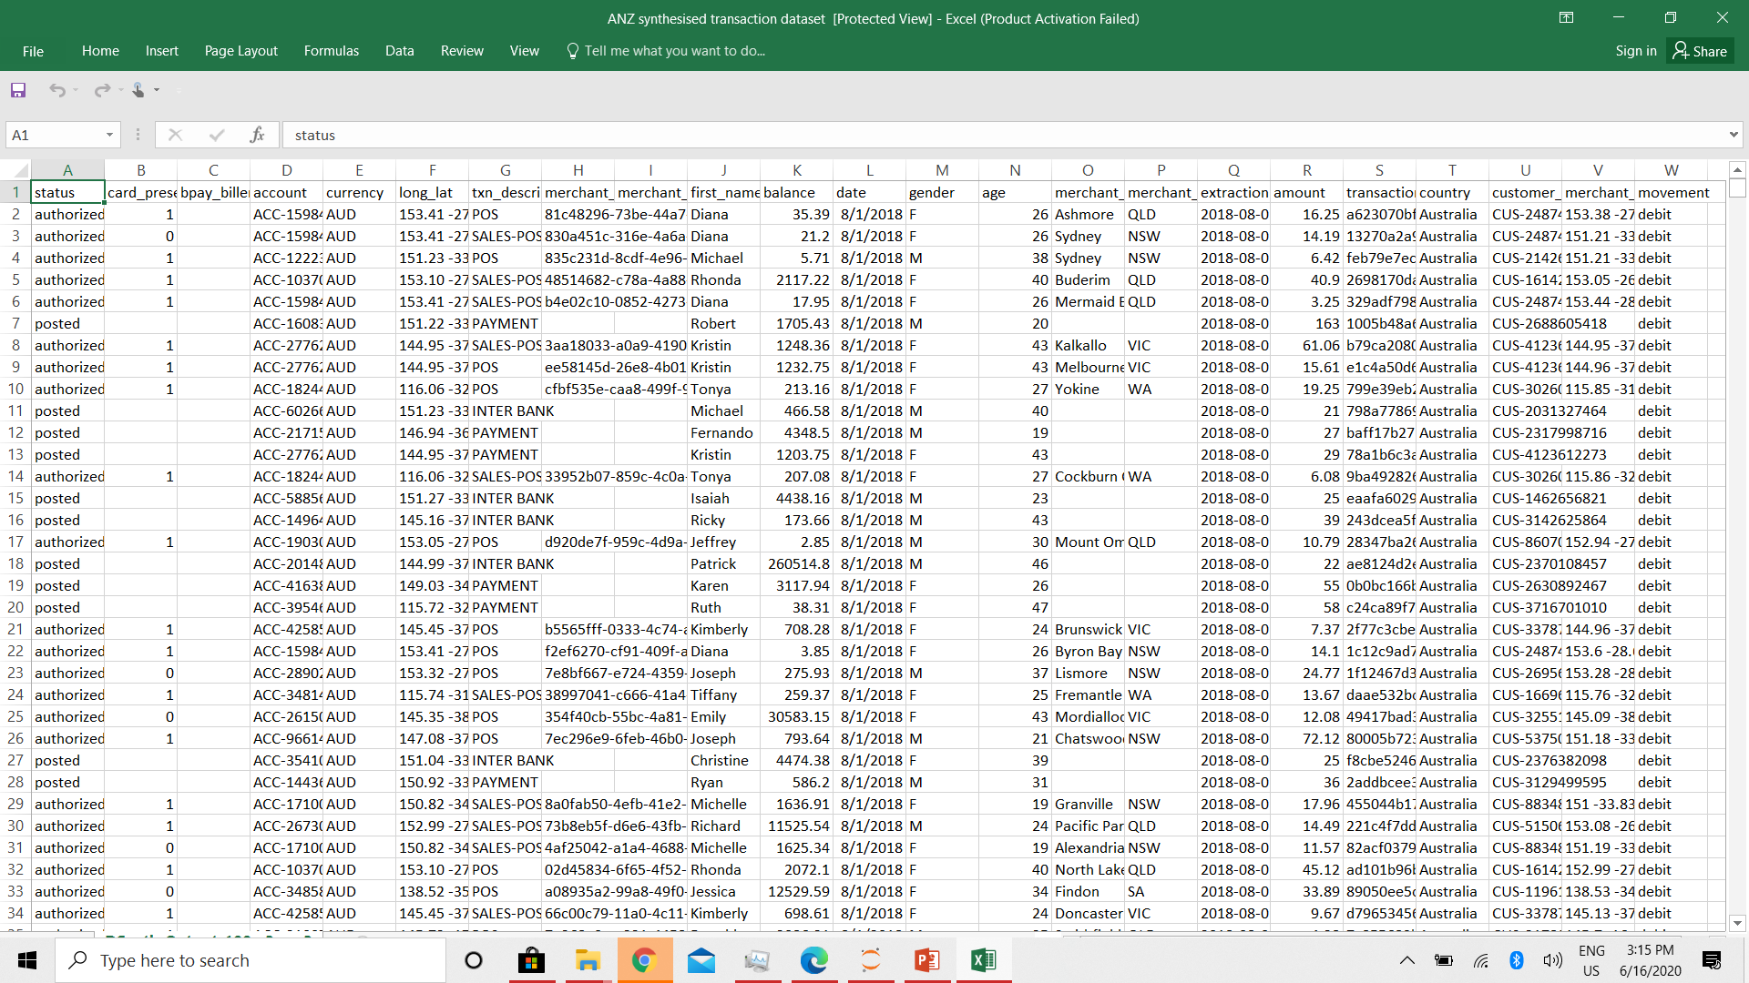
Data Exploration
I would be looking at the following in my exploration:
Age distributions
Number of bike purchases in 3 years / percentages purchases
Job industry category.
Wealth segments
Number of cars own on each states.

Slide 5
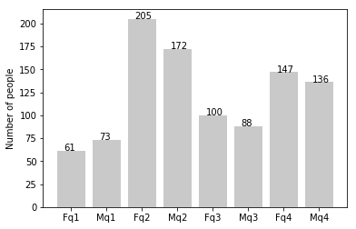
Age Distribution
As we can see, mostly our new customers are between 25 to 48 years old.
Number of customers from 48 to 59 years old has big drops on percentages.
q1: Under 25; q2: 25 to 48; q3: 48 to 59; q4: Over 59

Slide 6
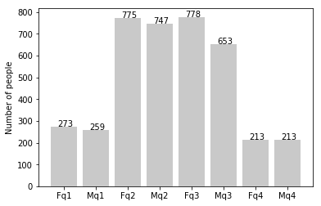
Age Distribution
There is a slightly increase in number of customers over 59 years old in term of percentages
It looks like the percentages of under 25 years old not really change.
q1: Under 25; q2: 25 to 48; q3: 48 to 59; q4: Over 59

Slide 7
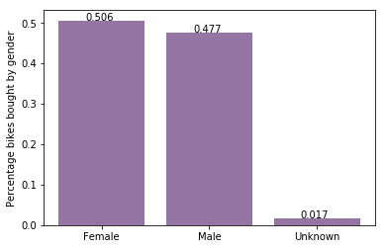
Bike Purchases in the last 3 yrs.
As we can see, our new customers mostly Female with 50.6% purchases with total of 25,212 bikes
Male contributed to 47.7% purchases with 23,765 bikes

Slide 8
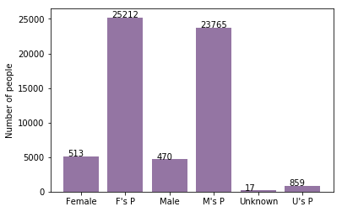
Bike Purchases in the last 3 yrs.
There should be more focus on advertises for Female customers than Male customers

Slide 9
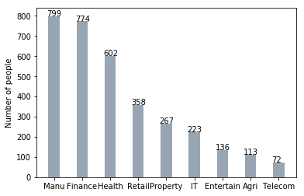
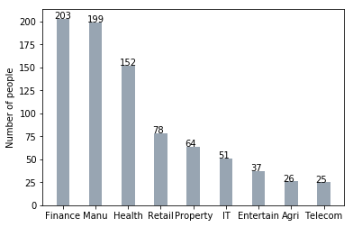
The Job Industry Category
Mostly our new customers are on Finance industry and our Manufacturing customers are still on top 2.
The rest industries is still same

Slide 10
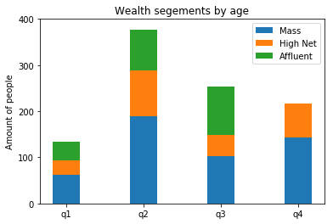
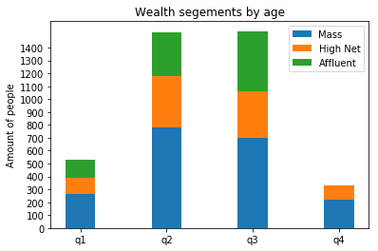
Wealth Segments
In all ages, the number of Mass Customers is the highest so we should focus on this social class.
After that, we should focus on High Net Customer.
Then Affluent Customers but mostly second and third quadrant.

Slide 11
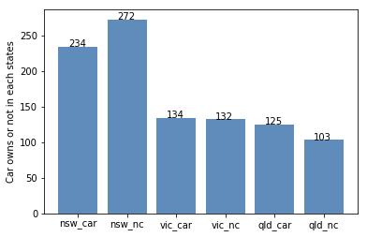
Numbers of Cars Owned
NSW should be considered the most since numbers of customers don’t own cars is significantly larger than that own.
VIC and QLD has more customers that own car that who don’t but we can try to have something so that those owns car will buy bikes.

